Slide 1

INTRODUCTION
By
MANISH KUMAR

Slide 2
About Recommendation System
1. What Is Recommendation System?
2. Use-Cases Of Recommendation System
a. Personalized Content:
b. Better Product search experience:
3. Types of Recommendation System
a. Popularity based
b. Content Based Filtering
c. Collaborative Based Filtering
d. Nearest Neighbor
e. Hybrid recommendations system

Slide 3
Point Of Discussion
Data summary
Exploratory Data Analysis
Models used for recommendations
Evaluation metrics
Conclusion

Slide 4

DATA SUMMARY
1. user_df
2. books_df
3. ratings_df
4. main dataframe: df
5. python libraries used

Slide 5
EXPLORATORY DATA ANALYSIS

Slide 6
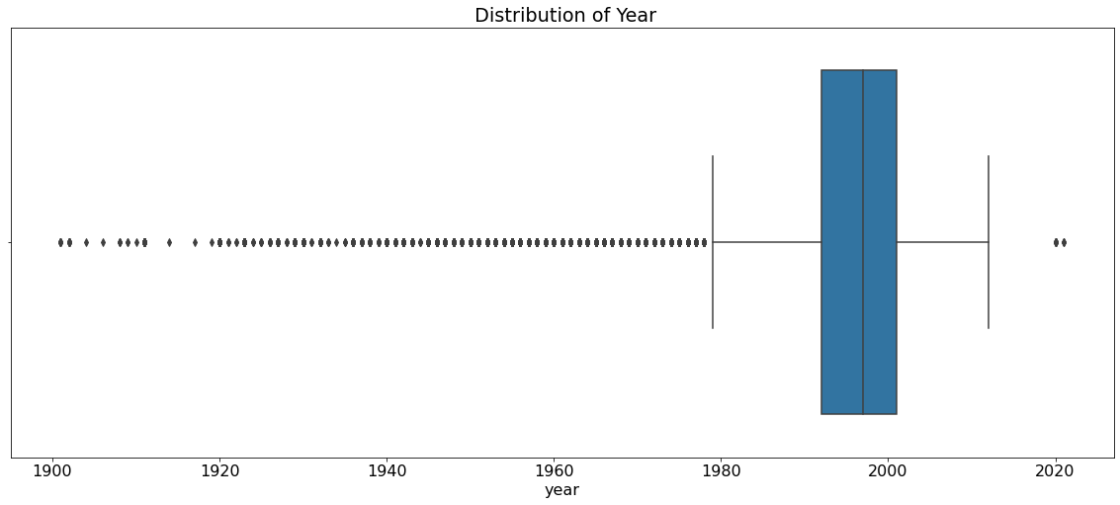
Distribution of Year

Slide 7
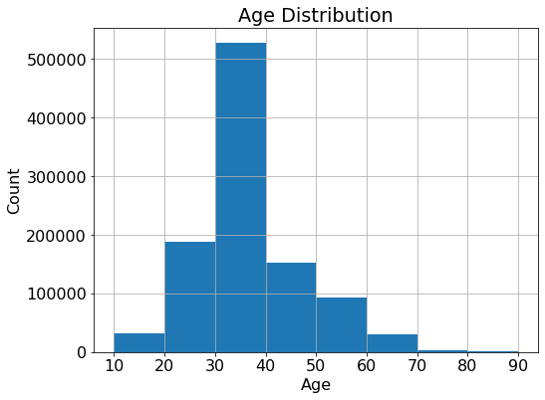
Distribution of Age

Slide 8
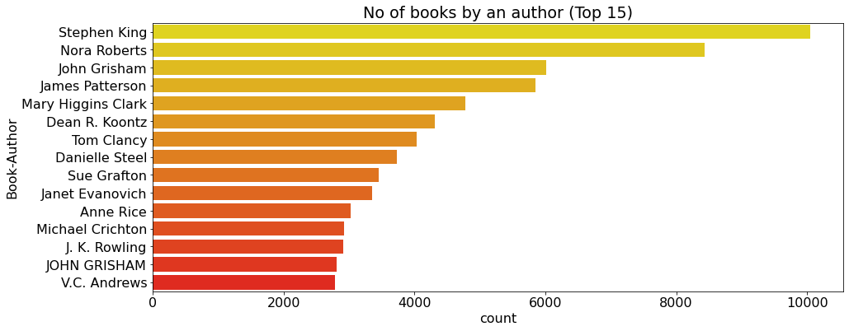
Top Authors

Slide 9
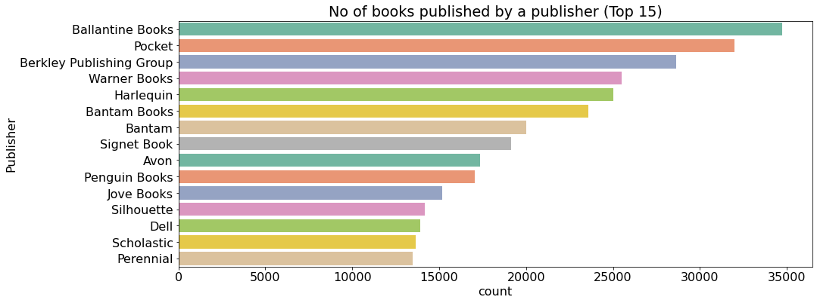
Top Publishers

Slide 10
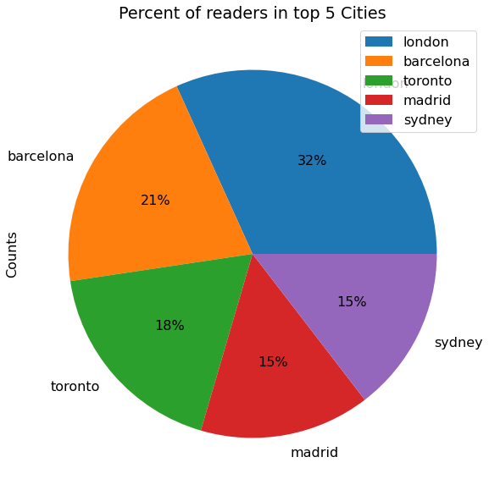
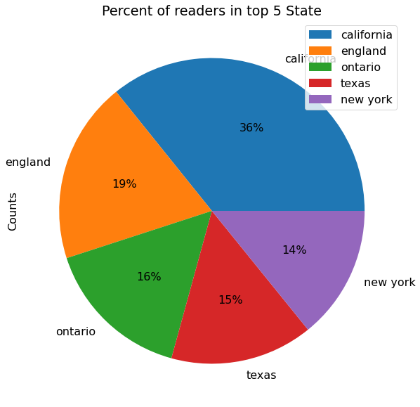
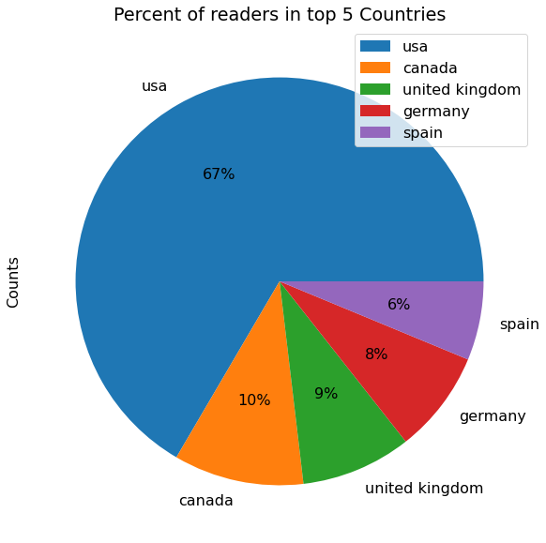
Top Readers in Location

Slide 11
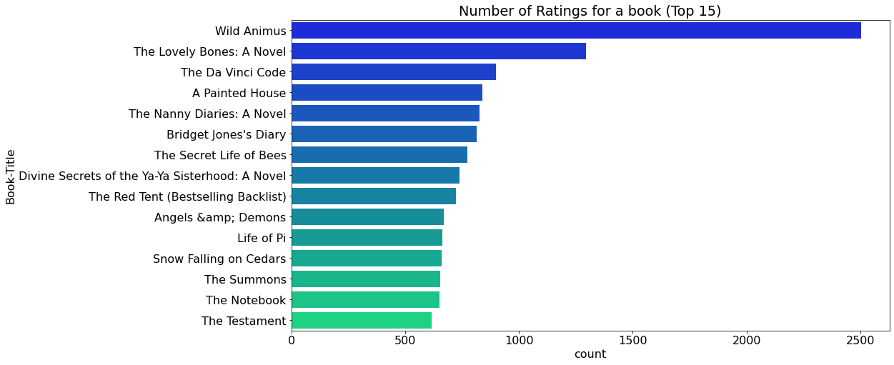
Top Books in Ratings

Slide 12
Recommendations Based On
Popularity
Collaborative Filtering(User-Item)
Correlations
Nearest Neighbours

Slide 13





Based On Popularity

Slide 14
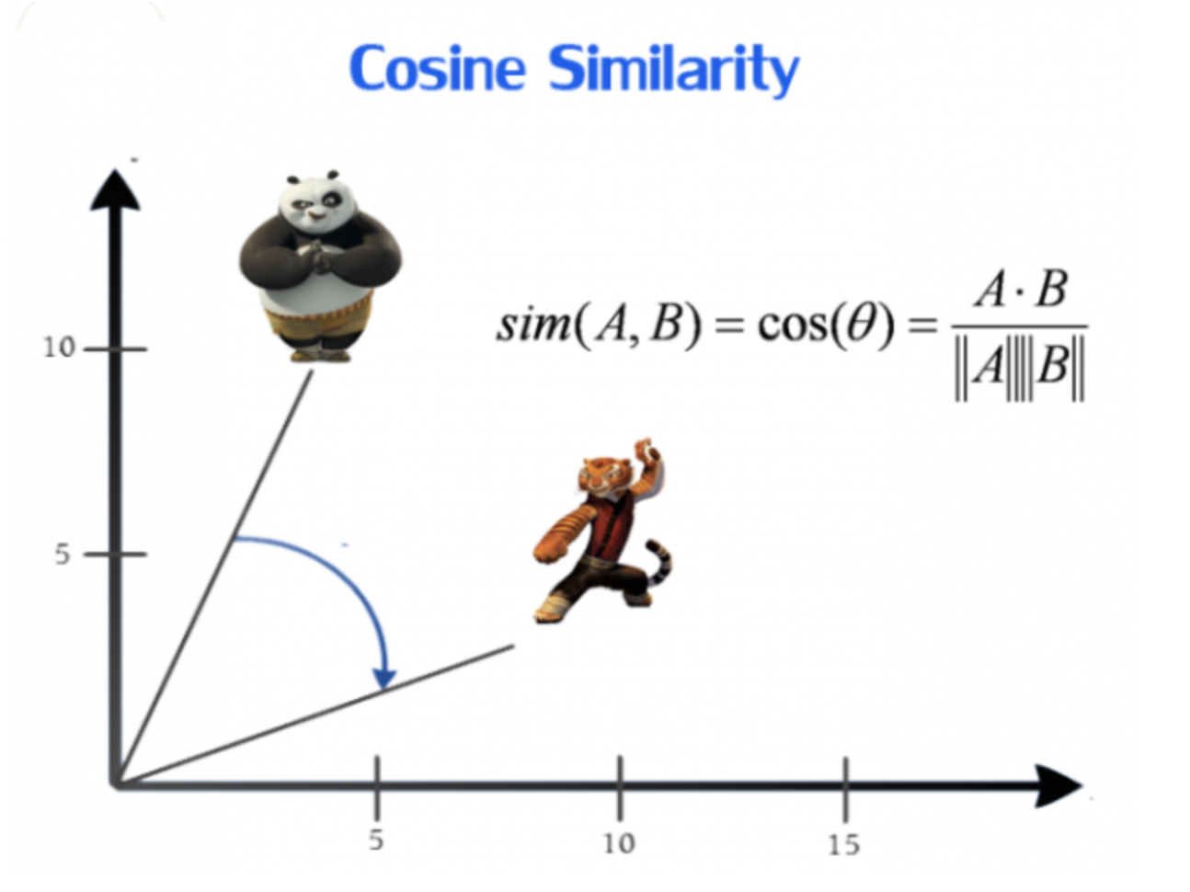

Collaborative Filtering
Metrics used : Cosine Similarity

Slide 15
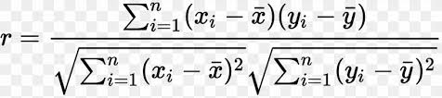

Based On Correlations
Metrics used: Pearson Correlations

Slide 16
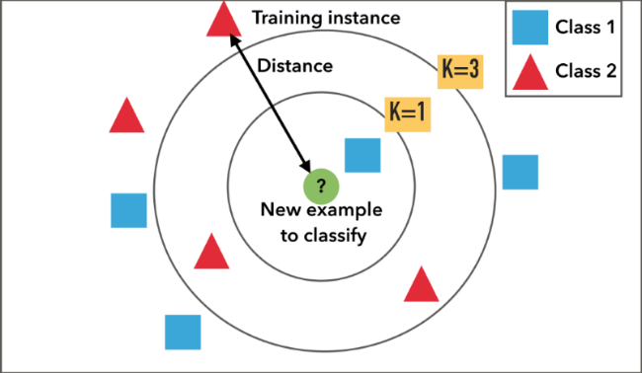
Based on Nearest Neighbors

Slide 17
Evaluation Metrics
Mean Average precision at K
Coverage
Personalization
Intralist Similarity

Slide 18
Conclusion
Out of all four methods we used for recommendation ,collaborative filtering and KNN performed best and gave results with almost 97% accuracy
we haven't used content based filtering but in instances with a new user or new item where little is known of the rating preference, collaborative filtering may not be the method of choice for generating recommendations. Content based filtering methods may be more appropriate. Often, a hybrid approach is taken for building real time recommendations using multiple different approaches in industry! The project can be extended to build hybrid recommendation systems in the future

Slide 19
THANK YOU

